Slide 1

COMP 5350 / 6350 / 6356 Digital Forensics Spring 2019

Slide 2
Project #1 Part #1 Partition #1

Slide 3
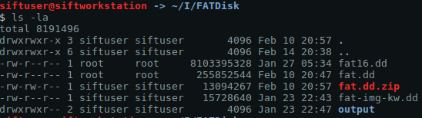
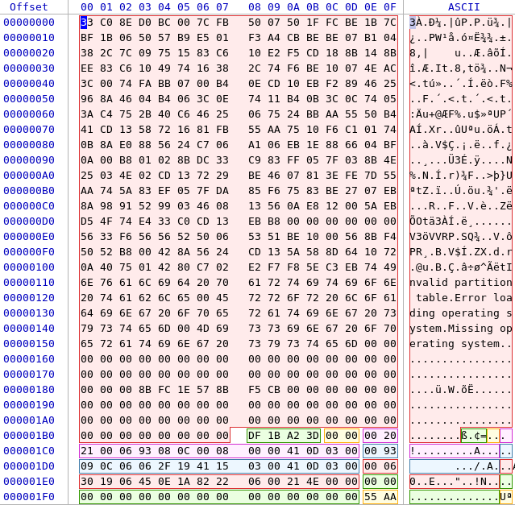
Partition Sector Start Locations
Partition #1: 0x800
Partition #2: 0x31541
Partition #3: 0x62282
Since these are the number
of sectors that we must move
to find the address we must
multiply by 512 bytes (0x200)
Partition #1: 0x100000
Partition #2: 0x62A8200
Partition #3: 0xC450400

Slide 4
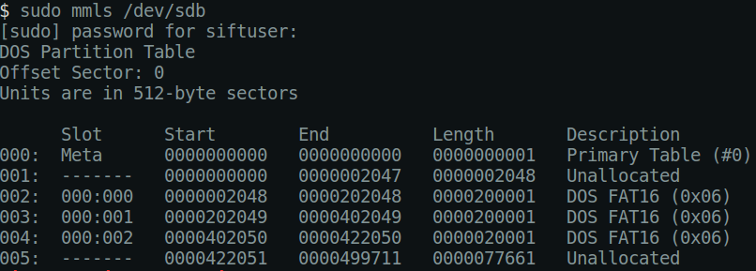
Partition Location Confirmation
Partition #1: 0x800 -> 2048
Partition #2: 0x31541 -> 202049
Partition #3: 0x62282 -> 402050

Slide 5
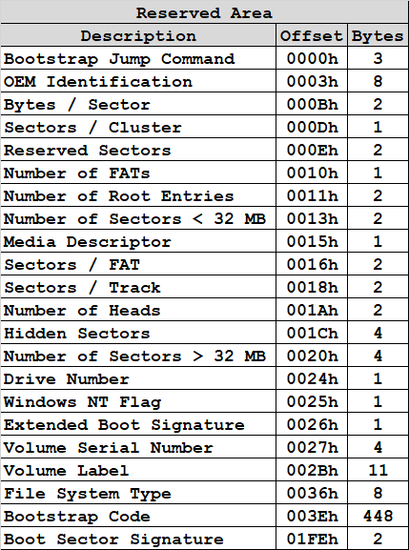
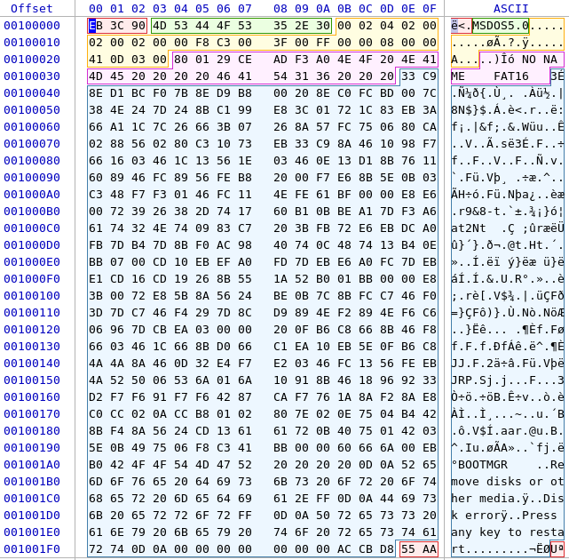
Partition #1 - FAT16
Information gathered from the partition boot record for use later in the partition
0x200 - 512
0x04
0x02 - 2
0x02
0x200 - 512
0xC3 - 195
0x800
0x30D41 – 200,001
0xA0F3ADCE
512 bytes / sector
4 sectors / cluster
2048 bytes / cluster

Slide 6
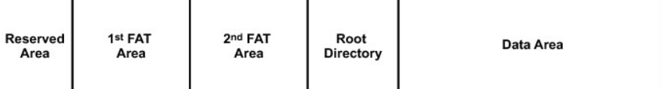
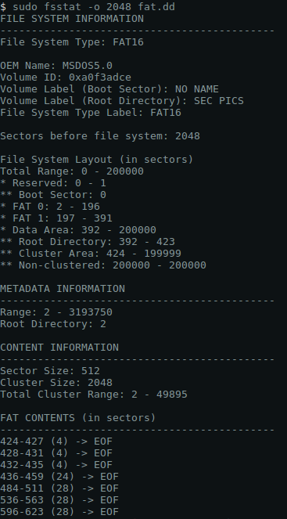
Partition #1 Areas
2
195
195
32
199,576
Sector 2 - 196
Sector 197 - 391
Sector 424 - 200000
Sector 0 - 1
Sector 392 - 423
Used to
Confirm
Results

Slide 7
Partition #1 Areas
Commands to display the contents of each area:
Reserved Area
Skip 2048 Sectors
2 Sectors Long
sudo dd if=fat.dd skip=2048 count=2 | hexdump -C
FAT #1
Skip 2050 Sectors
195 Sectors Long
sudo dd if=fat.dd skip=2050 count=195 | hexdump -C
FAT #2
Skip 2245 Sectors
195 Sectors Long
sudo dd if=fat.dd skip=2245 count=195 | hexdump -C
Root Directory
Skip 2440 Sectors
32 Sectors Long
sudo dd if=fat.dd skip=2440 count=32 | hexdump -C
Data Area
Skip 2472 Sectors
199,576
sudo dd if=fat.dd skip=2472 count=199576 | hexdump -C

Slide 8
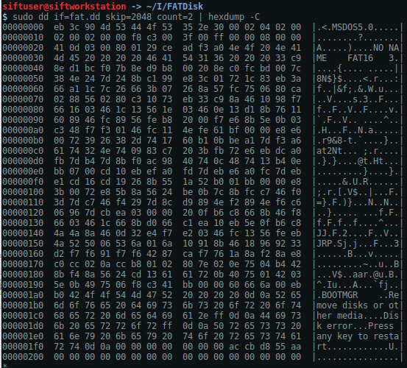
Boot Sector
sudo dd if=fat.dd skip=2048 count=2 | hexdump -C

Slide 9
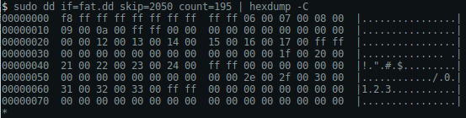
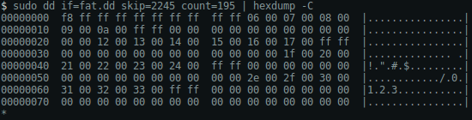
FAT #1 & FAT #2
sudo dd if=fat.dd skip=2050 count=195 | hexdump -C
sudo dd if=fat.dd skip=2245 count=195 | hexdump -C
Remember that after the first 4 bytes (i.e. 0xF8FF and 0xFFFF) the values represent either:
The Next Cluster (0x????)
End of File (0xFFFF)
No Content (0x0000)

Slide 10
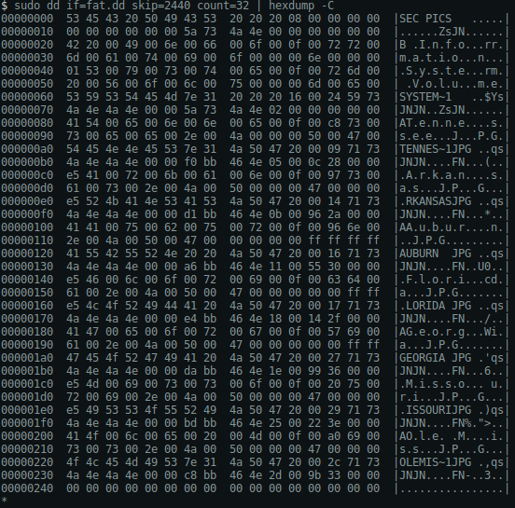
Root Directory Structure
sudo dd if=fat.dd skip=2440 count=32 | hexdump -C

Slide 11
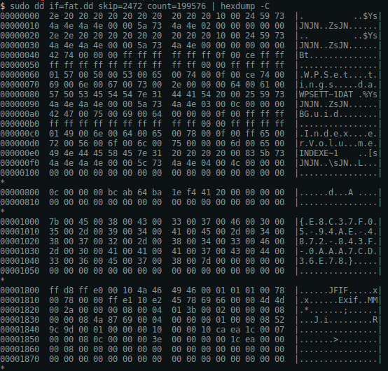
Data Area
sudo dd if=fat.dd skip=2472 count=199576 | hexdump -C

Slide 12
File Allocation Table
Static
System
The first user
file starts at 0x0005
Allocated
Unallocated
Data Area Cluster | Next Cluster
0x0000 | 0xFFF8
0x0001 | 0xFFFF
0x0002 | 0xFFFF
0x0003 | 0xFFFF
0x0004 | 0xFFFF
0x0005 | 0x0006
0x0006 | 0x0007
0x0007 | 0x0008
0x0008 | 0x0009
0x0009 | 0x000A
0x000A | 0xFFFF
0x000B | 0x0000
0x000C | 0x0000
0x000D | 0x0000
0x000E | 0x0000
0x000F | 0x0000
Data Area Cluster | Next Cluster
0x0010 | 0x0000
0x0011 | 0x0012
0x0012 | 0x0013
0x0013 | 0x0014
0x0014 | 0x0015
0x0015 | 0x0016
0x0016 | 0x0017
0x0017 | 0xFFFF
0x0018 | 0x0000
0x0019 | 0x0000
0x001A | 0x0000
0x001B | 0x0000
0x001C | 0x0000
0x001D | 0x0000
0x001E | 0x001F
0x001F | 0x0020
Data Area Cluster | Next Cluster
0x0020 | 0x0021
0x0021 | 0x0022
0x0022 | 0x0023
0x0023 | 0x0024
0x0024 | 0xFFFF
0x0025 | 0x0000
0x0026 | 0x0000
0x0027 | 0x0000
0x0028 | 0x0000
0x0029 | 0x0000
0x002A | 0x0000
0x002B | 0x0000
0x002C | 0x0000
0x002D | 0x002E
0x002E | 0x002F
0x002F | 0x0030
Data Area Sector | Next Sector
0x0030 | 0x0031
0x0031 | 0x0032
0x0032 | 0x0033
0x0033 | 0xFFFF
0x0034 | 0x0000
0x0035 | 0x0000
0x0036 | 0x0000
0x0037 | 0x0000
0x0038 | 0x0000
0x0039 | 0x0000
0x003A | 0x0000
0x003B | 0x0000
0x003C | 0x0000
0x003D | 0x0000
0x003E | 0x0000
0x003F | 0x0000
416
420
424
428
432
436

Slide 13
Where does file data start?
The start of user
file contents is
at sector 436
2 + 195 + 195 + 32 + 12 = 436
2
195
195
32
199,576
Sector 2 - 196
Sector 424-200000
Sector 197-391
Sector 0 - 1
Sector 392-423

Slide 14
Root Directory Files and Status
First 3 Entries
Are Not User Files
Active Files: 4
Tennessee.jpg
Auburn.jpg
Georgia.jpg
Ole Miss.lpg
Deleted Files: 3
Arkansas.jpg
Florida.jpg
Missouri.jpg

Slide 15
Filename, Cluster, & Size
Filename | Cluster | Size
Tennessee.jpg | 0x0005 | 10,252
_rkansas.jpg | 0x000B | 10,899
Auburn.jpg | 0x0011 | 12,373
_lorida.jpg | 0x0018 | 12,052
Georgia.jpg | 0x001E | 13,977
_issouri.jpg | 0x0025 | 15,906
Ole Miss.jpg | 0x002D | 13,211

Slide 16
File Recovery
2 + 195 + 195 + 32 + 12 = 436
0-1
2-196
197-391
392-423
424-200000
Exaggerated view of where each
file resides in the data area
512 bytes / sector
4 sectors / cluster
2048 bytes / cluster
460
512
564
436
484
536
596
Filename | Status | Cluster (Hex) | Cluster (Dec) | Start Sector (Partition) | Start Sector (Disk) | Storage Address (Hex) | Bytes (Disk) | Size (Bytes)
Tennessee.jpg | Active | 0x0005 | 5 | 436 | 2484 | 0x136800 | 1,271,808 | 10,252
Arkansas.jpg | Deleted | 0x000B | 11 | 460 | 2508 | 0x139800 | 1,284,096 | 10,899
Auburn.jpg | Active | 0x0011 | 17 | 484 | 2532 | 0x13C800 | 1,296,384 | 12,373
Florida.jpg | Deleted | 0x0018 | 24 | 512 | 2560 | 0x140000 | 1,310,720 | 12,052
Georgia.jpg | Active | 0x001E | 30 | 536 | 2584 | 0x143000 | 1,323,008 | 13,977
Missouri.jpg | Deleted | 0x0025 | 37 | 564 | 2612 | 0x146800 | 1,337,344 | 15,906
Ole Miss.jpg | Active | 0x002D | 45 | 596 | 2644 | 0x14A800 | 1,353,728 | 13,211

Slide 17
File Recovery Commands
Filename | Status | Cluster (Hex) | Cluster (Dec) | Start Sector (Partition) | Start Sector (Disk) | Storage Address (Hex) | Bytes (Disk) | Size (Bytes)
Tennessee.jpg | Active | 0x0005 | 5 | 436 | 2484 | 0x136800 | 1,271,808 | 10,252
Arkansas.jpg | Deleted | 0x000B | 11 | 460 | 2508 | 0x139800 | 1,284,096 | 10,899
Auburn.jpg | Active | 0x0011 | 17 | 484 | 2532 | 0x13C800 | 1,296,384 | 12,373
Florida.jpg | Deleted | 0x0018 | 24 | 512 | 2560 | 0x140000 | 1,310,720 | 12,052
Georgia.jpg | Active | 0x001E | 30 | 536 | 2584 | 0x143000 | 1,323,008 | 13,977
Missouri.jpg | Deleted | 0x0025 | 37 | 564 | 2612 | 0x146800 | 1,337,344 | 15,906
Ole Miss.jpg | Active | 0x002D | 45 | 596 | 2644 | 0x14A800 | 1,353,728 | 13,211
Tennessee.jpg (Active)
sudo dd if=fat.dd of=TennesseeActive.jpg bs=1 skip=1271808 count=10252
Arkansas.jpg (Deleted)
sudo dd if=fat.dd of=ArkansasDeleted.jpg bs=1 skip=1284096 count=10899
Auburn.jpg (Active)
sudo dd if=fat.dd of=AuburnActive.jpg bs=1 skip=1296384 count=12373
Florida.jpg (Deleted)
sudo dd if=fat.dd of=FloridaDeleted.jpg bs=1 skip=1310720 count=12052
Georgia.jpg (Deleted)
sudo dd if=fat.dd of=GeorgiaActive.jpg bs=1 skip=1323008 count=13977
Missouri.jpg (Deleted)
sudo dd if=fat.dd of=MissouriDeleted.jpg bs=1 skip=1337344 count=15906
Ole Miss.jpg (Active)
sudo dd if=fat.dd of=OleMissActive.jpg bs=1 skip=1353728 count=13211

Slide 18
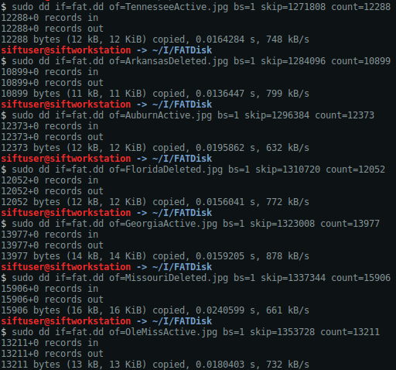
Recover Files
Notice how fsstat only shows the four active files, but does not show the deleted files
This occurs since the deleted files reside in unallocated space
at this point

Slide 19






Recovered Images for Partition #1

Slide 20
Project #1 FAT Partition #1 Student Examples

Slide 21
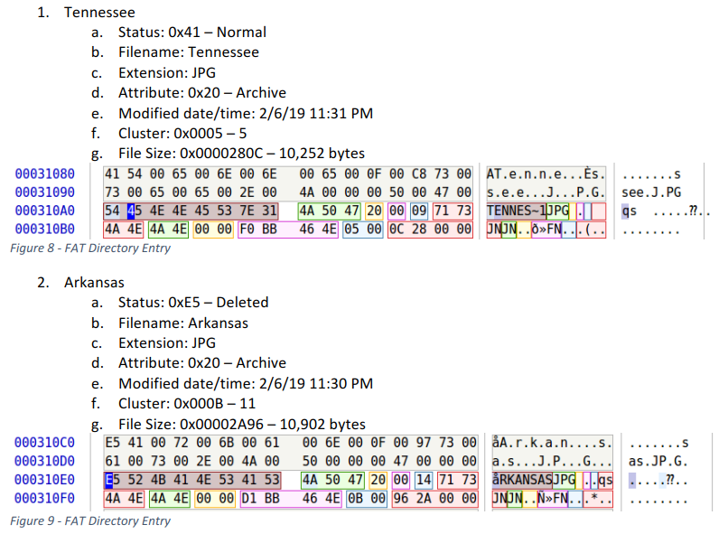
FAT Partition #1 – Root Directory

Slide 22
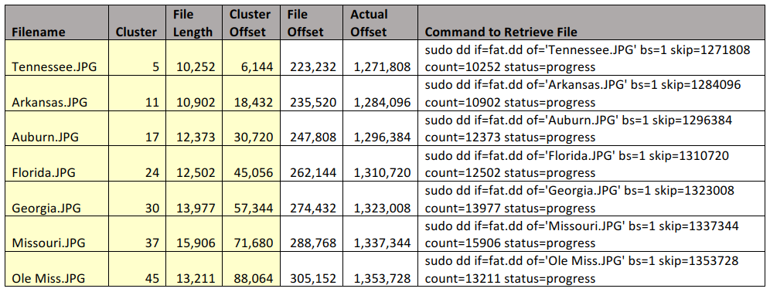
FAT Partition #1 – Final Results

Slide 23
Project #1 FAT Partition #2 Student Examples

Slide 24
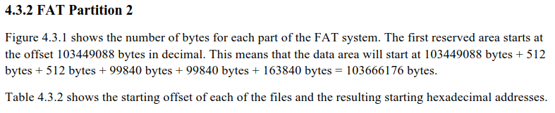
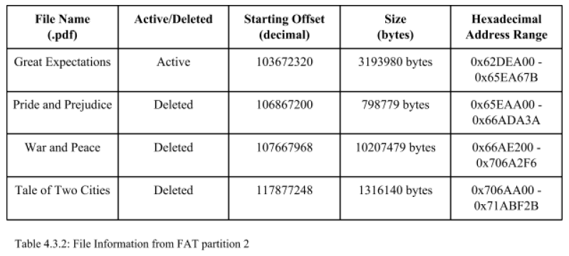
FAT Partition #2

Slide 25
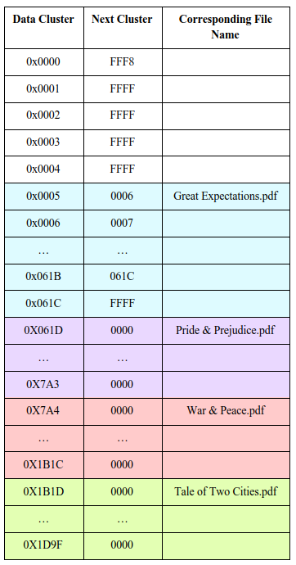
FAT Partition #2 File Allocation Table

Slide 26
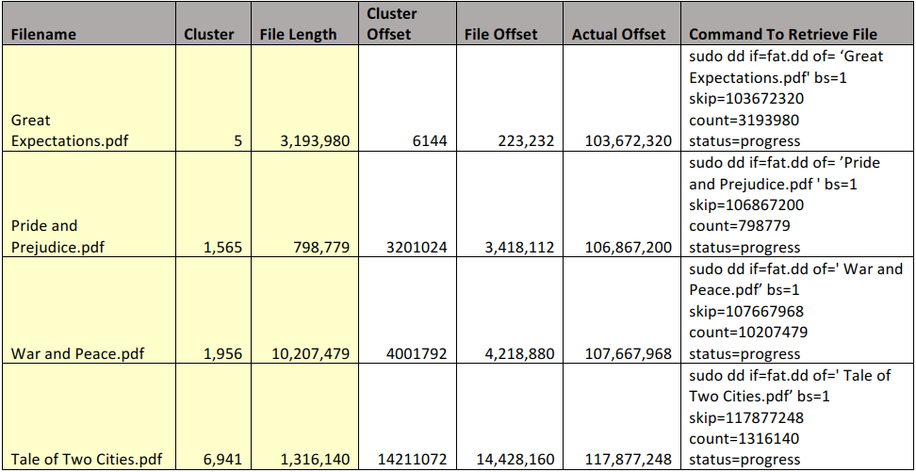
FAT Partition #2

Slide 27
Project #1 FAT Partition #3 Student Examples

Slide 28
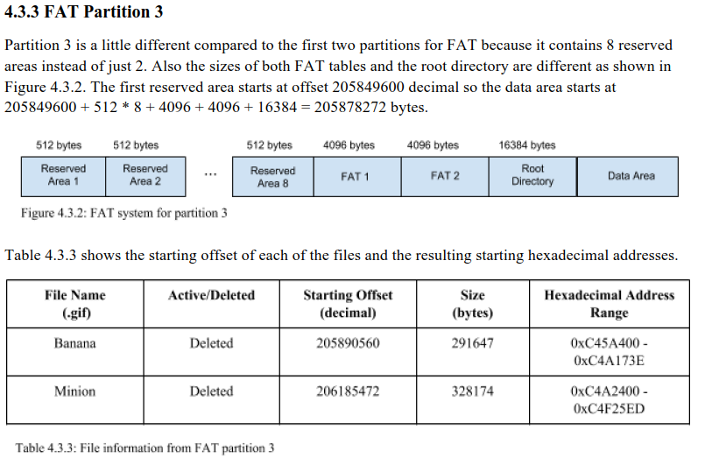
FAT Partition #3

Slide 29
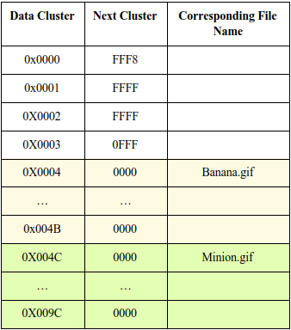
FAT Partition #3 File Allocation Table

Slide 30
Project #1 NTFS Partition Student Examples

Slide 31
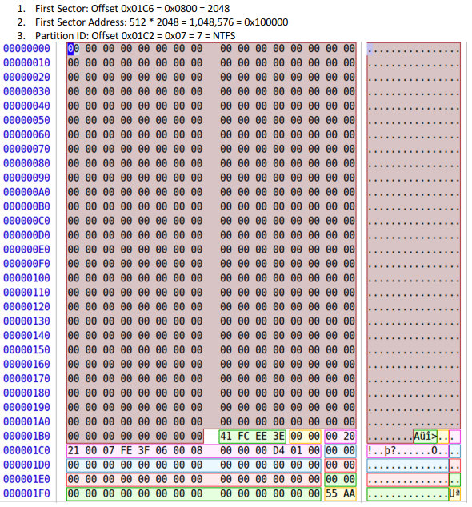
NTFS Partition

Slide 32
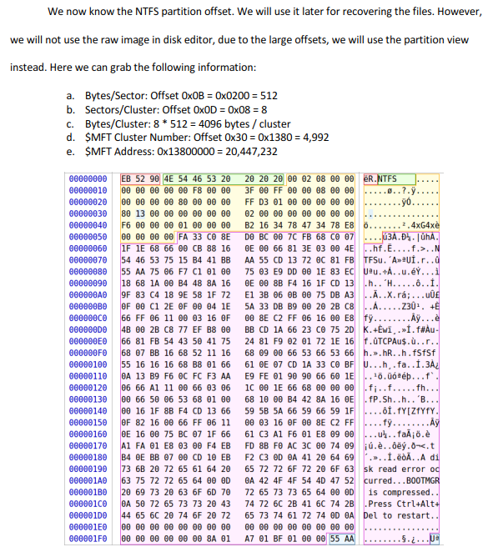
NTFS Partition

Slide 33
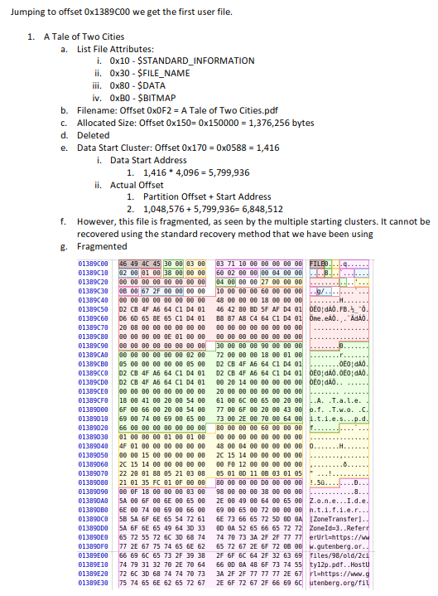
NTFS Partition – File Attributes

Slide 34
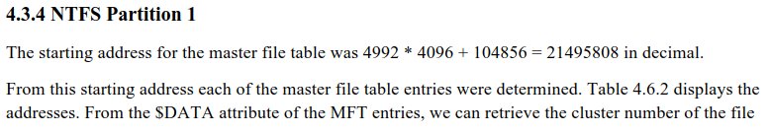
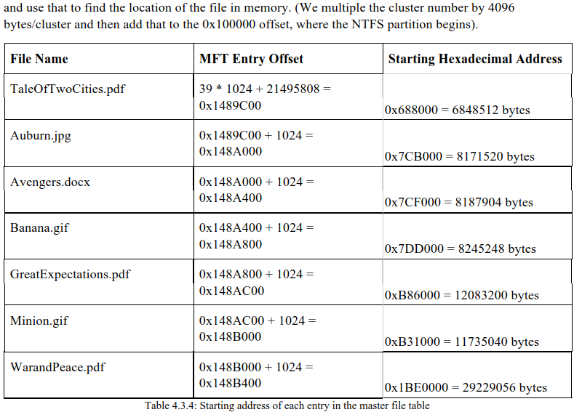
NTFS Partition – Storage Addresses

